Slide 1
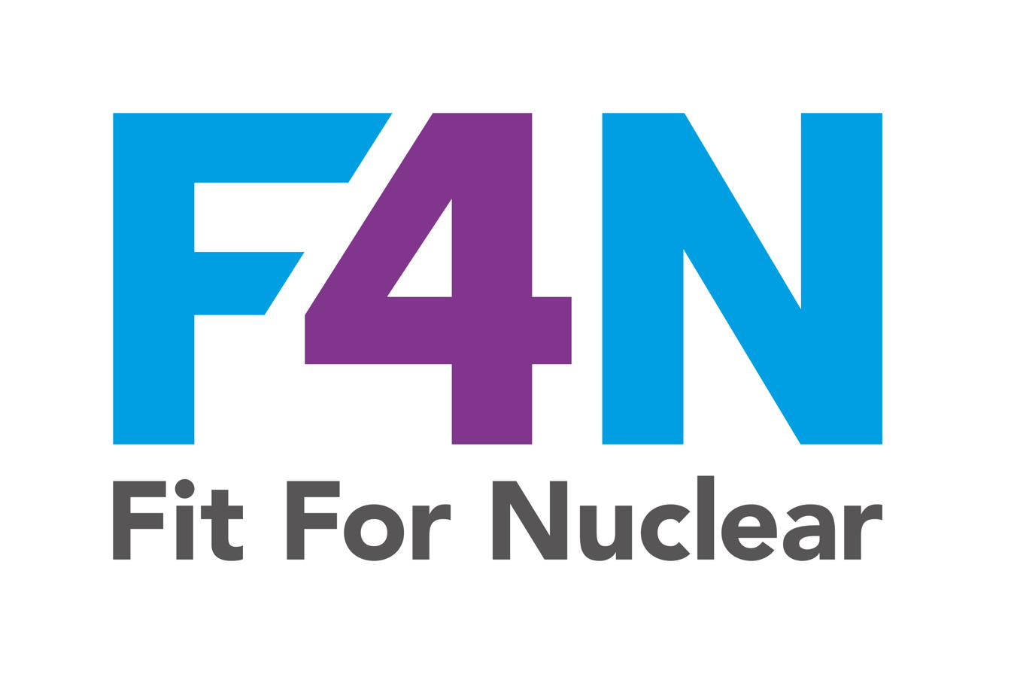
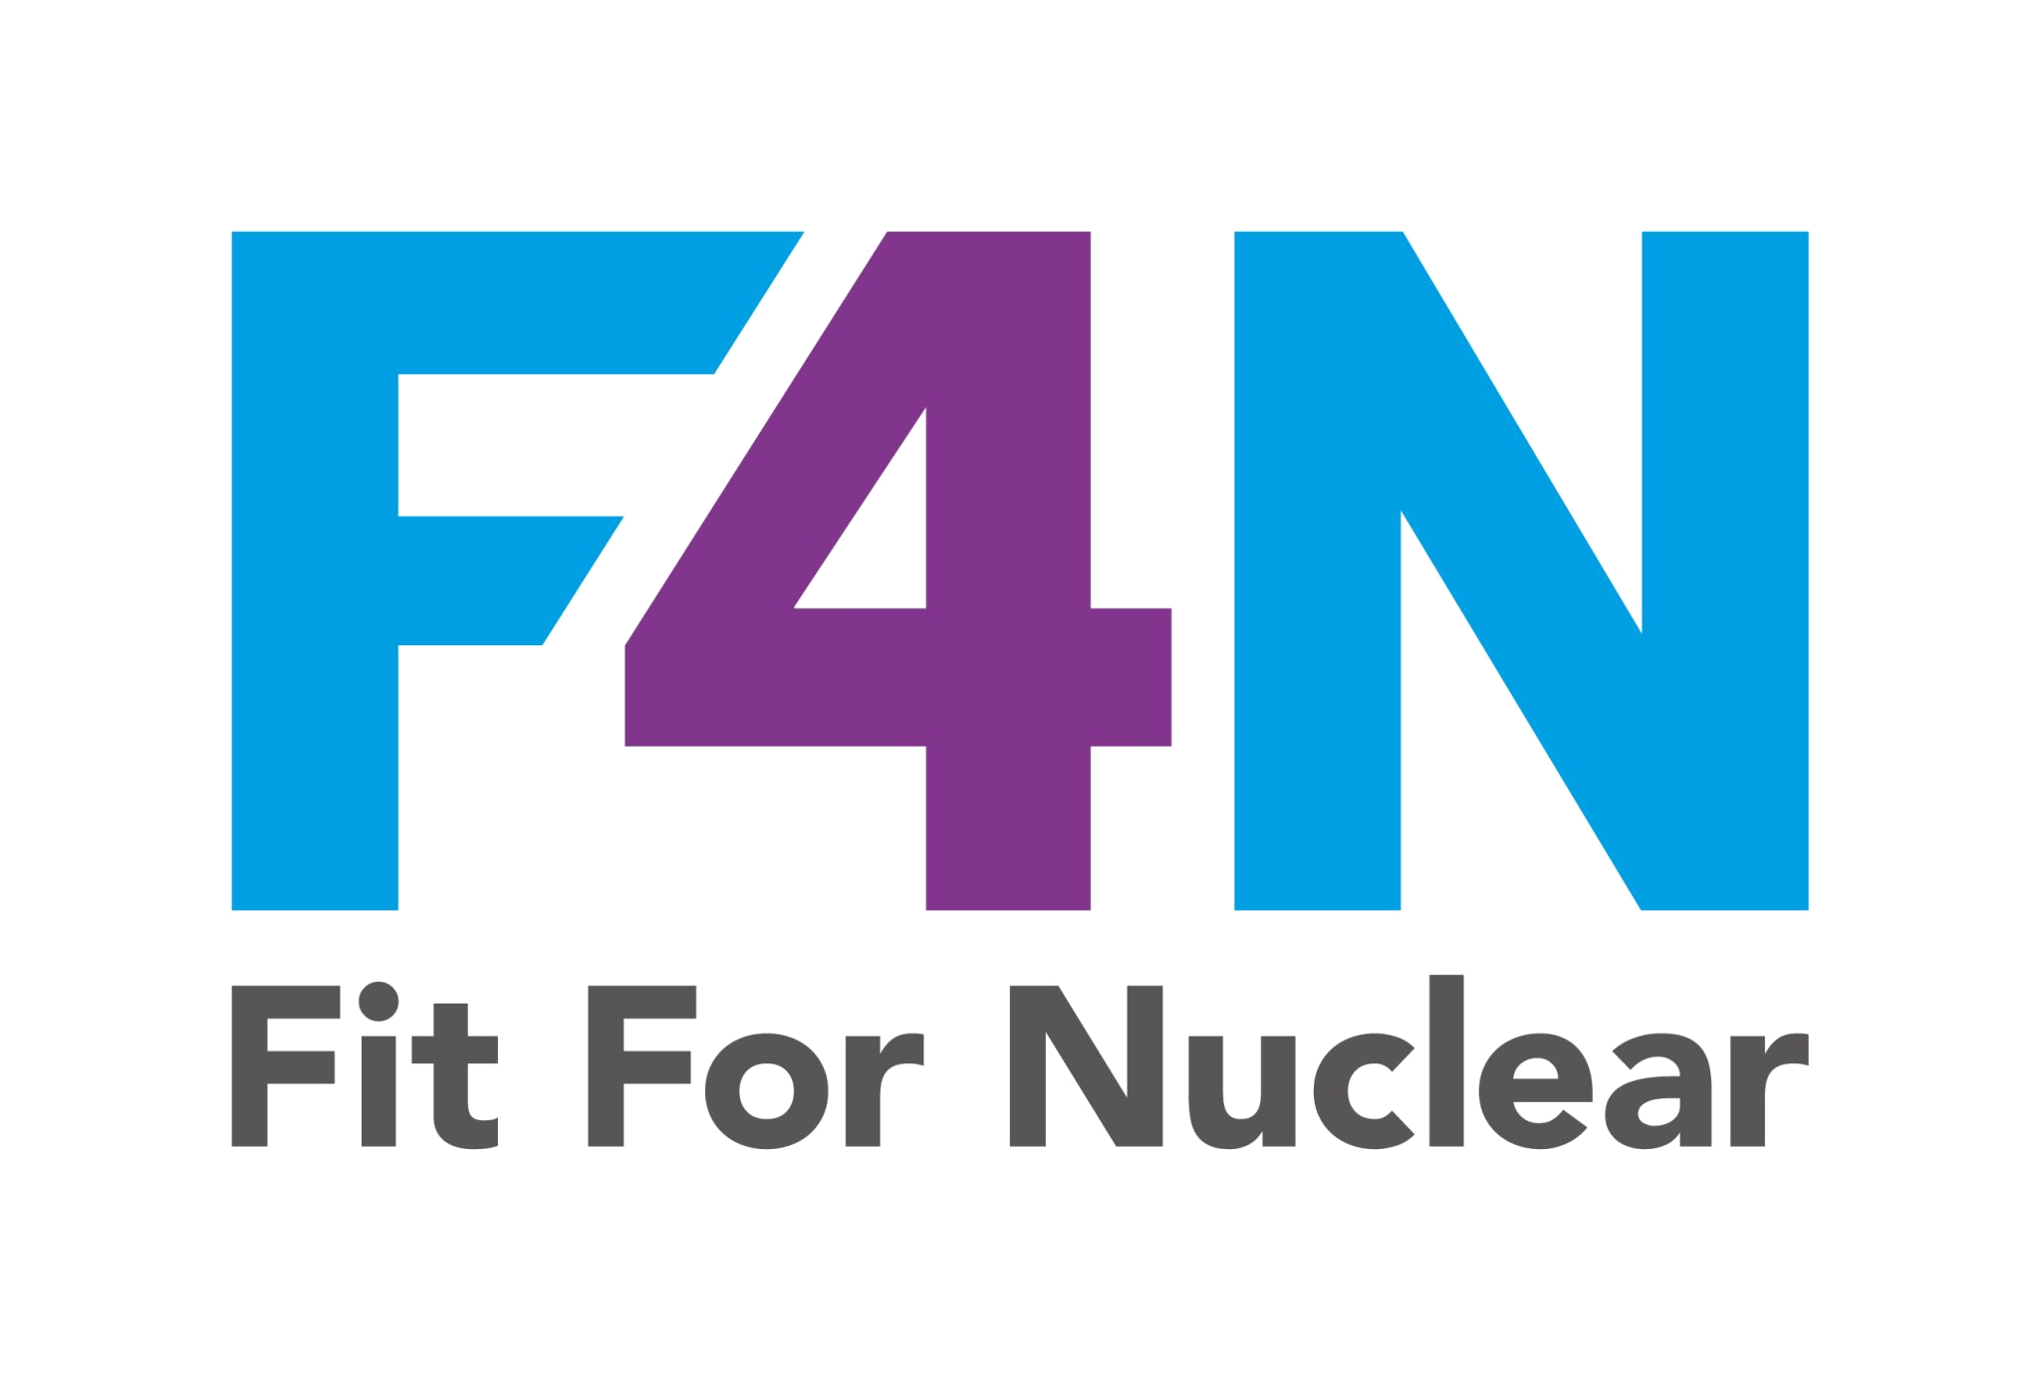

OUR VALUES
These are the principles that guide everything we do — every job, every day.
⚑
SAFETY FIRST
★
QUALITY WITHOUT COMPROMISE
✓
HONESTY AND INTEGRITY
No job is so important and no deadline so urgent that we cannot take the time to do it safely. Safety is never compromised.
In nuclear, quality is not a nice-to-have. We get it right first time, every time. Our customers and the public depend on it.
We are straight with each other and with our customers. We raise problems rather than hide them. We do what we say we will do.
↑
CONTINUOUS IMPROVEMENT
♦
RESPECT FOR PEOPLE
◉
NUCLEAR AWARENESS
We never stop looking for a better way. Every person has the ability and the responsibility to improve the way we work.
We treat everyone with dignity and respect. We value different perspectives. We look out for each other.
We understand the unique responsibilities that come with working in the nuclear supply chain and we take them seriously.
NucCol | Nuclear Collaboration Ltd · Fit For Nuclear Programme · Commercial in Confidence | 1

Slide 2
SAFETY IS EVERYONE'S RESPONSIBILITY
Stop. Think. Act Safely. Every time.
YOU HAVE THE RIGHT TO STOP WORK
REPORT EVERY NEAR MISS
If you are not sure it is safe, stop. You will never be penalised for raising a safety concern. Stopping to check is always the right decision.
Near misses are warnings. Every one reported is an accident prevented. There are no silly reports. If it nearly went wrong, we need to know.
FOLLOW THE SAFE SYSTEM OF WORK
LOOK OUT FOR EACH OTHER
Risk assessments and Safe Systems of Work exist for a reason. They are not optional. Do not take shortcuts with safety procedures.
If you see a colleague about to do something unsafe, speak up. We all go home in the same condition we arrived in.
Emergency: 999 | First Aider: [Name] [Location] | Assembly Point: [Location] | Near Miss Reports: [System / location]
NucCol | Nuclear Collaboration Ltd · Fit For Nuclear Programme · Commercial in Confidence | 2

Slide 3
QUALITY: RIGHT FIRST TIME, EVERY TIME
In nuclear, there is no room for 'good enough'. Our customers depend on precision.
1
FOLLOW THE DRAWING
2
MAINTAIN TRACEABILITY
3
RAISE AN NCR
Work to the drawing. If you are unsure, ask before you start. Never assume dimensions or tolerances.
Material identification must be maintained at all times. Never remove markings. Tag offcuts before moving them.
If something is wrong, raise a Non-Conformance Report immediately. Do not pass on defective work.
4
COMPLETE YOUR PAPERWORK
5
CFSI VIGILANCE
6
CONSERVATIVE DECISIONS
Sign the traveller at every stage. Your signature is your personal confirmation the work is correct.
Check every delivery for signs of counterfeit or suspect items. If in doubt, quarantine and tell the Quality Manager.
When in doubt, stop. Ask. The cost of stopping is always less than the cost of getting it wrong in nuclear.
NucCol | Nuclear Collaboration Ltd · Fit For Nuclear Programme · Commercial in Confidence | 3

Slide 4
OUR PERFORMANCE
[Month / Week] | How we are doing against our key targets
SAFETY
Near Misses Reported
QUALITY
Right First Time %
DELIVERY
On Time In Full
[X]
[X%]
[X%]
Target: [X]+
Target: [X%]
Target: 95%
↑ More reporting = stronger safety culture
↑ vs last month
→ vs last month
COST
Scrap and Rework
PEOPLE
Ideas Submitted
NUCLEAR
NCR Rate
£[X]
[X]
[X]
Target: <£[X]
Target: [X]+
Target: 0 on QC1/2
↓ vs last month
[X] implemented this month
vs last month
THIS MONTH'S FOCUS: [Write the team's main priority for the month here]
NucCol | Nuclear Collaboration Ltd · Fit For Nuclear Programme · Commercial in Confidence | 4
Updated by: [Name] | Date: [Date] | Next update: [Date]

Slide 5
WORKING IN THE NUCLEAR SUPPLY CHAIN
What makes us different. What makes us trusted.
Why does nuclear quality matter so much?
What does conservative decision-making mean?
1
Components in a nuclear facility can be in service for 60 years. The work you do today may be relied upon by people who have not yet been born. That is why we get it right.
2
When in doubt, stop and ask. In nuclear, the cost of stopping to verify is always less than the cost of getting it wrong. You have the authority to stop your own work at any time.
What is graded quality?
Why does traceability matter so much?
3
Not every component has the same safety significance. QC1 items are safety-critical and need 100% inspection. QC4 items are commercial standard. The classification determines how we work.
4
Nuclear facilities need to trace every component back to its raw material source, sometimes decades later. That is why we never remove identification marks and always complete our travellers.
What is CFSI and why should I care?
What is F4N?
5
Counterfeit, Fraudulent, and Suspect Items are a real risk. A fake component in a nuclear plant could cause a safety event. At goods receipt, check every delivery. If it looks wrong, quarantine it.
6
Fit For Nuclear is how we demonstrate to nuclear customers that our quality, safety, and management systems are at the standard they require. Every one of us contributes to it every day.
NucCol | Nuclear Collaboration Ltd · Fit For Nuclear Programme · Commercial in Confidence | 5

